Slide 1

TESTING FOR LIBRARY APPLICATION
M.VEERA VASANTH
192111342
C S E
Software Testing for Android application.
CSA3731
Date : 31/01/2023

Slide 2
objectives
The main objective of the Library Services is to offer free book reading facilities to all.
Books for reference and research purpose, to publish bibliographies

Slide 3
ABSTRACT
Library management system which maintains the information. about the books present in the library, their authors, the members of library to. whom books are issued, library staff and all.
It mainly focuses on basic operations in a library like adding new member, new books.
It testing the updating new information, searching books and members and facility to borrow and return books.
Testing the book availability in the library application.
This is an ANDROID application and only a registered user can access the application.
Library Management system is developed to automate the task of entering the records of new book and retrieving the details of book available in the library.

Slide 4
PROPOSED WORK
To develop the library management App using android studio.
Run the application using emulator.
Testing the library management system app for positive and negative outcomes.
Appium interacts with an application automatically and run the tests repeatedly against the given application at various sessions.
View all books in the library app and also we can add the books, modify the books.
The user can search for books they wish to collect and send a request to the admin

Slide 5
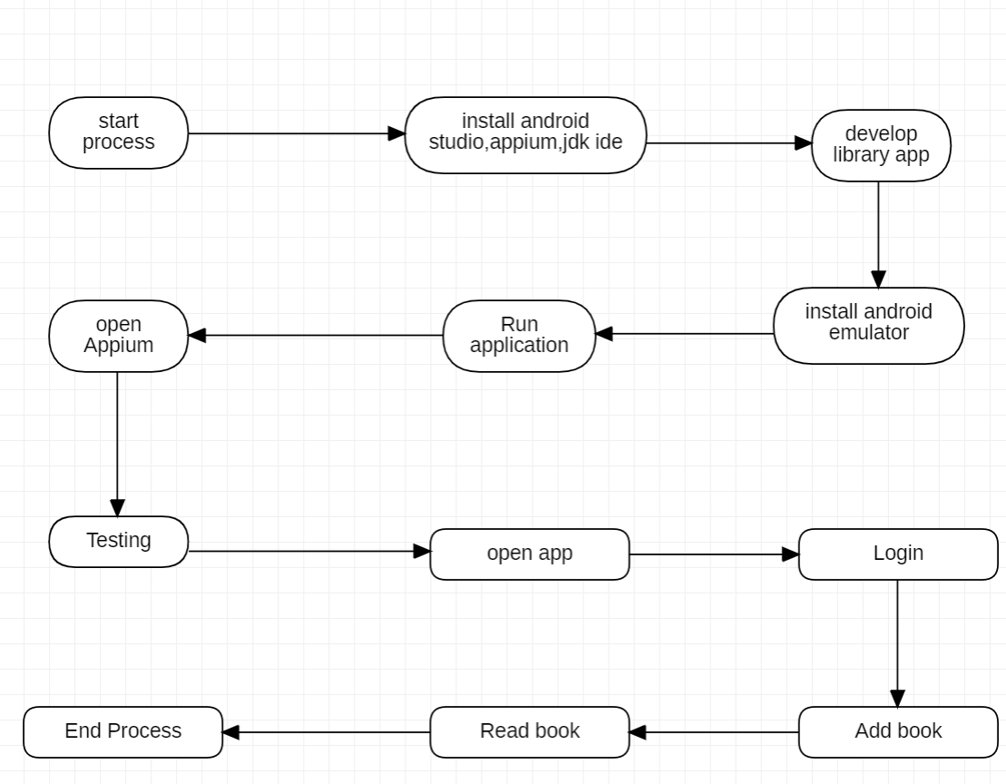
Flow Chart for Library Management System:

Slide 6
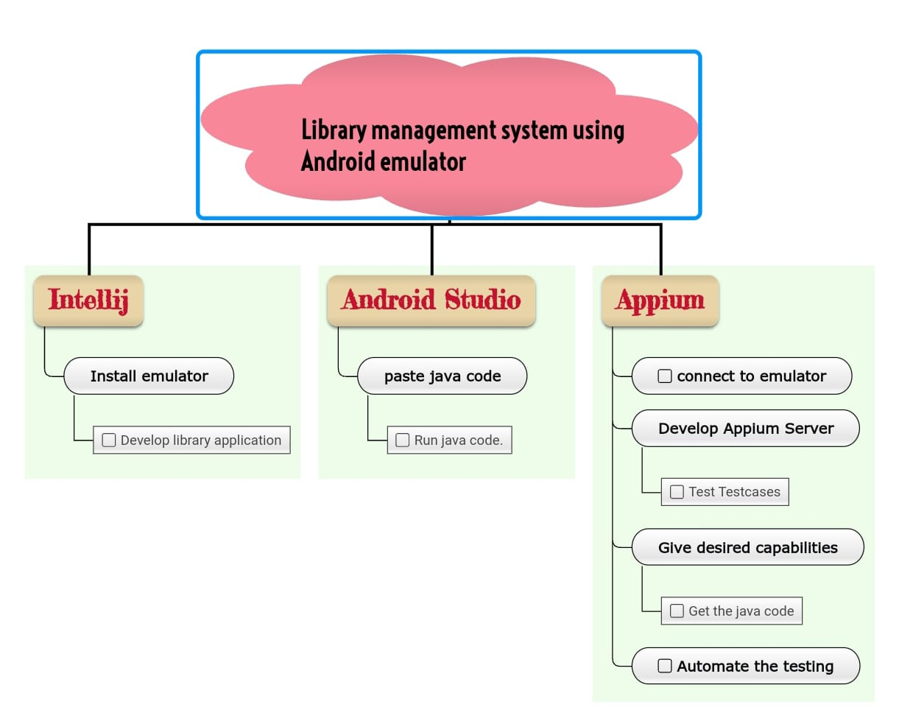
Concept map :

Slide 7
Test cases:
Open app
User login
Admin login
Add book
Search and preview books
Know the availability of books.
Request for New Books
Read E-Paper
Download the Book in PDF
logout

Slide 8



Applications used:
APPIUM
Intellij
Android studio

Slide 9
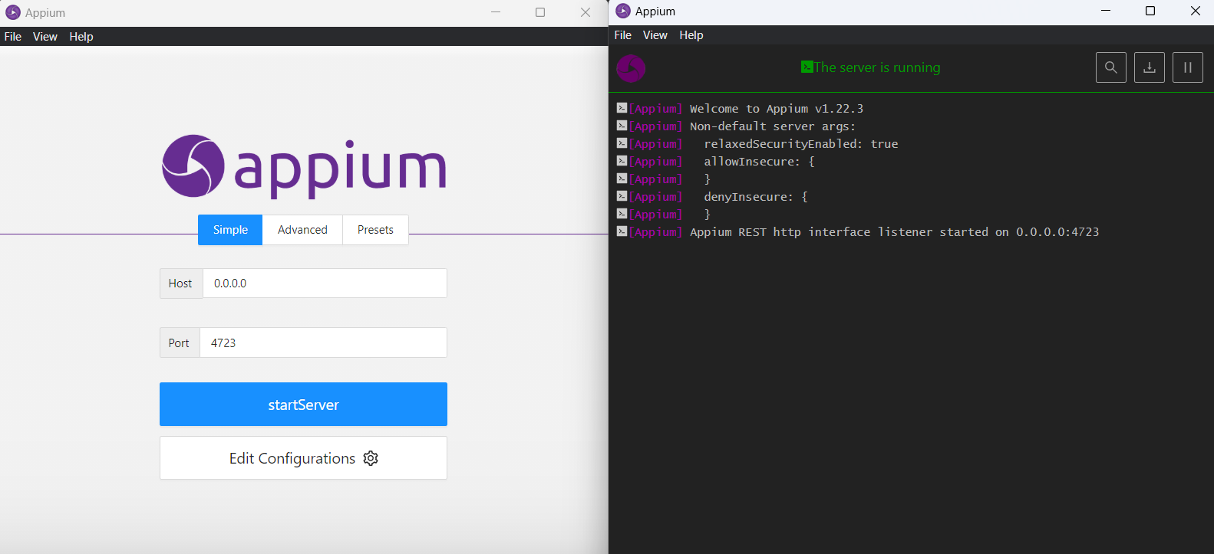
Appium server :

Slide 10
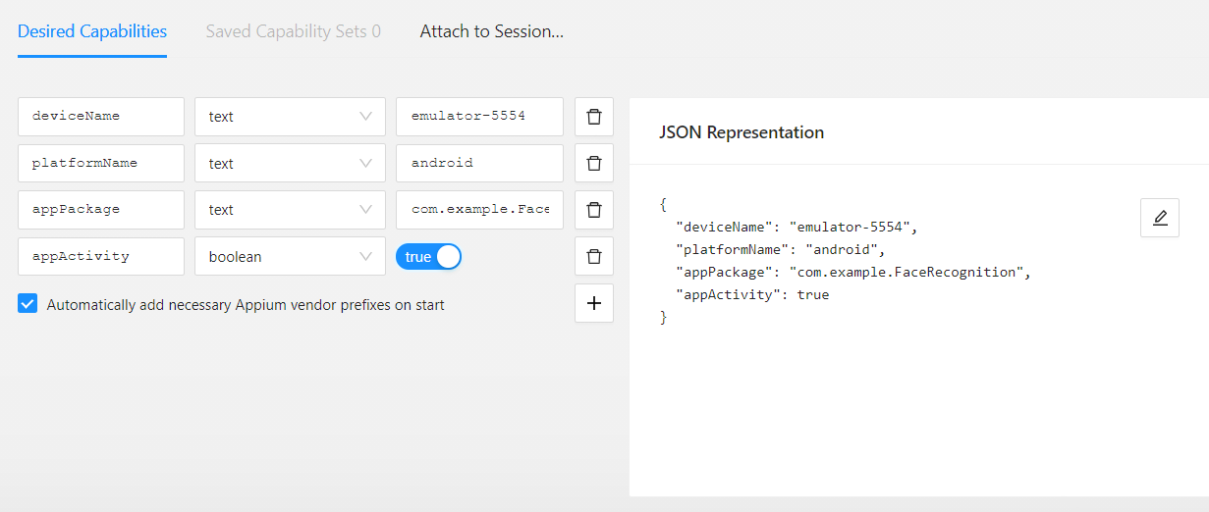
Appium server inspector :

Slide 11
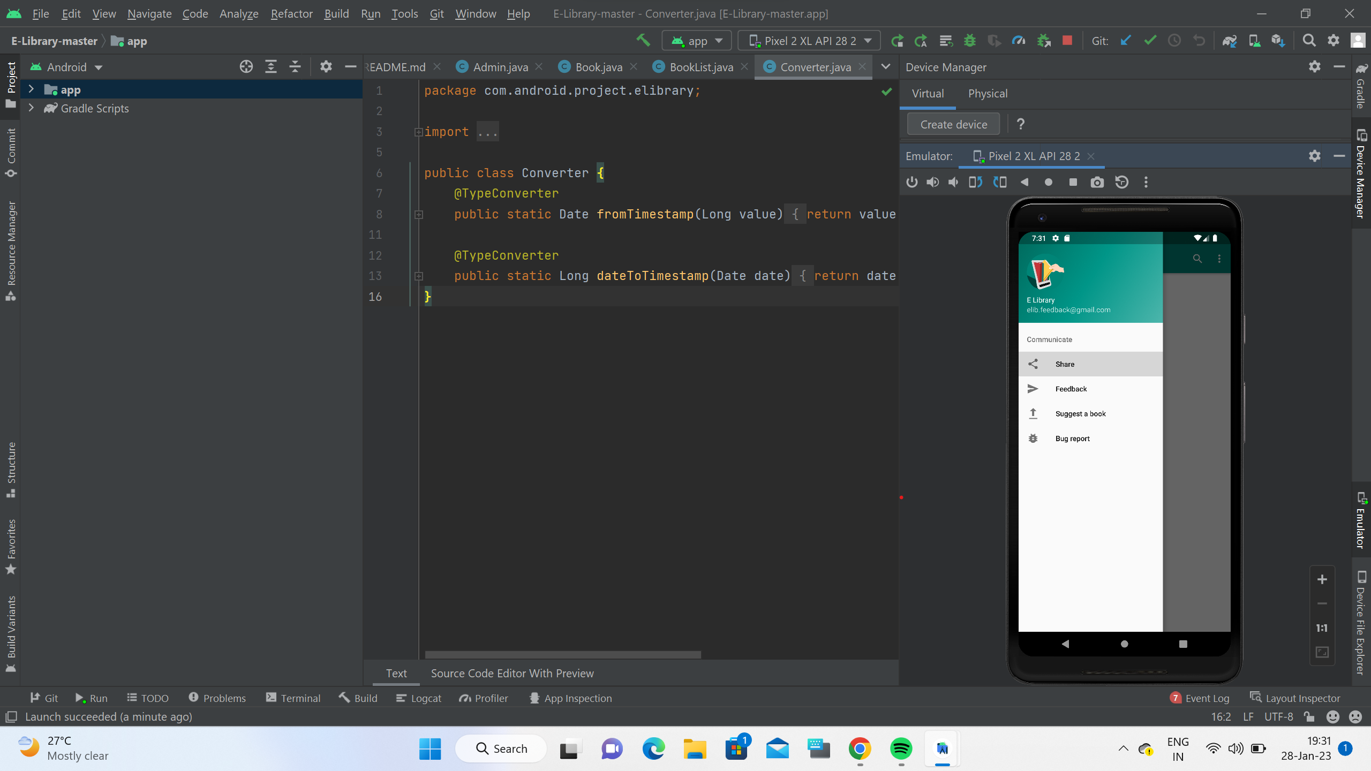
TESTING OUTPUT :

Slide 12
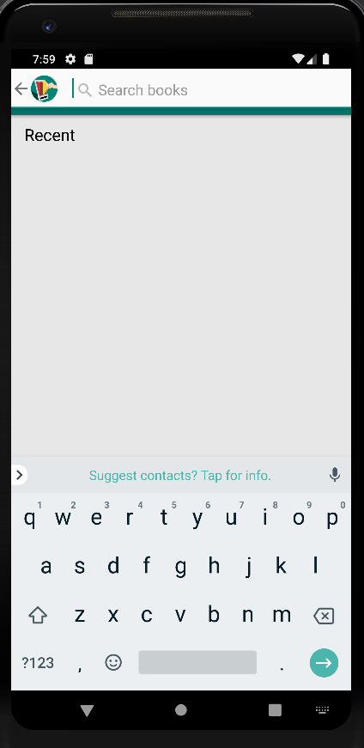
Testing Output :

Slide 13
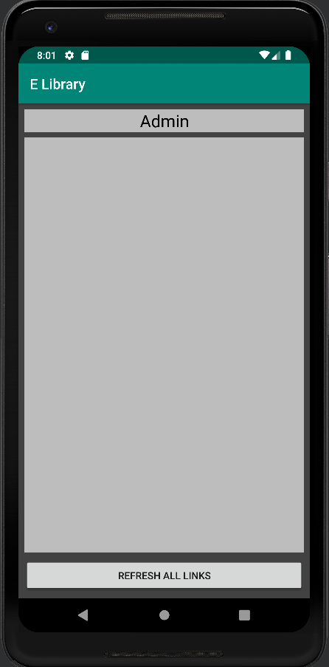
Testing output :

Slide 14
Test case outcomes:
TESTCASES | OUTCOME
Verify if a user/admin is able to login with valid username and password | (Positive)
Verify if a user is giving feedback. | (Positive)
Verify the forgot password functionality | (Positive)
Verify the message for invalid login | (Positive)
Verify the not remember me functionality | (Negative)
Verify if user is able to login with a new password only after he/she changed the password | (positive)
Verify the admin is able to adding books | (Positive)
Verify the user is reading book | (Positive)
Verify the user is downloading book | (Positive)
verify user is searching for book and it does not shown in the list. | (Negative)

Slide 15
Conclusion :
The library Management System has been computed successfully and was also tested successfully by taking “test cases”. It is user friendly, and has required options, which can be utilized by the user to perform the desired operations.
The software is developed using XML coding as front end and Java coding as back end in Windows environment.

